Slide 1

PokerGame
Team 3
So Mi Choi, Bo Heon Jeong, Hanchen Li,
Sang Rhee, Yixin Wang, Yuying Wang
https://github.com/srhee91/PokerGame

Slide 2
Problem motivation
People need to have fun gambling without losing actual money online. An interactive Texas Hold’em
game can be created to satisfy this need.

Slide 3
Project goal
Our project will create an interactive poker game written in Java that can support up to 8 players by the end of the semester.

Slide 4
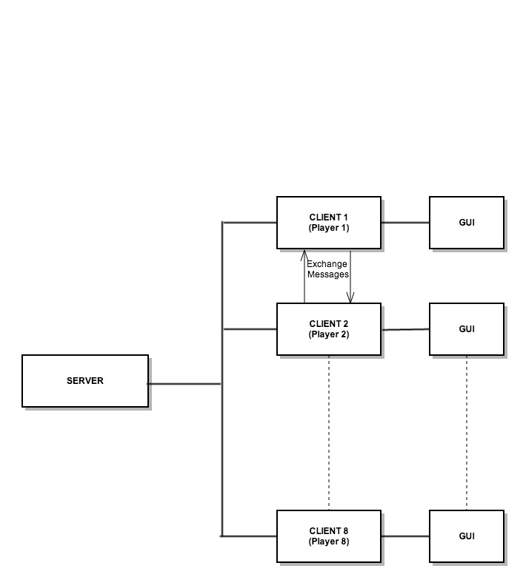
Design Outline

Slide 5
Demo-1
1. Integrate the already-existing OngoingMode animations to correctly respond to received GameState from the host to show each player’s actions.
2. Expand the GameState class to include each player’s most recent action so that the OngoingMode GUI can accurately display status labels for each player.
3. Show Timer and fold

Slide 6
Demo-2
_{4. Show Quit button}
5. Show disconnection (quiting or network error) , update the GameSystem and remove player
6. Debug the Rank class through adding test cases that handle all possibilities of poker-hands in the TestRank class. (User story 4)
7. Debug the GUI portion of the game by play-testing the game with all possible user inputs.
_{(User story 4)}

Slide 7
Demo-3
8. Debug the GameSystem portion of the game by play-testing the game with all possible user inputs.
9. Debug the Network (ClientMessageHandler, HostMessageHandler, HostBroadcaster, HostSearcher) portion of the game by simulating network issues and disconnects and host Crashing.

Slide 8
The end

